Slide 1
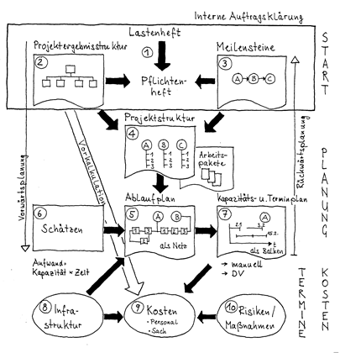
Project name
Team meeting
Picture of the Project
student 1, student 2, student 3…...
Darmstadt, dd.mm.yy

Slide 2
Content
  Schedule
  Status
  Next Steps
Project Management | Prof. Dr.-Ing. P. Fromm | University of Applied Sciences Darmstadt

Slide 3
Schedule
  Provide a copy of the updated schedule (Excel)
Project Management | Prof. Dr.-Ing. P. Fromm | University of Applied Sciences Darmstadt

Slide 4
Responsibilities
Workpackage | Member 1 | Member 2 | Member 3 | Member 4
<WP1> | X
<WP2> |  | X
…
Project Management | Prof. Dr.-Ing. P. Fromm | University of Applied Sciences Darmstadt

Slide 5
Workpackage <name>, <owner>
Achieved results
  ...
Risks / Problems
  ...
Next steps
  ...
Project Management | Prof. Dr.-Ing. P. Fromm | University of Applied Sciences Darmstadt

Slide 6

Conclusion
Project Management | Prof. Dr.-Ing. P. Fromm | University of Applied Sciences Darmstadt

